Slide 1
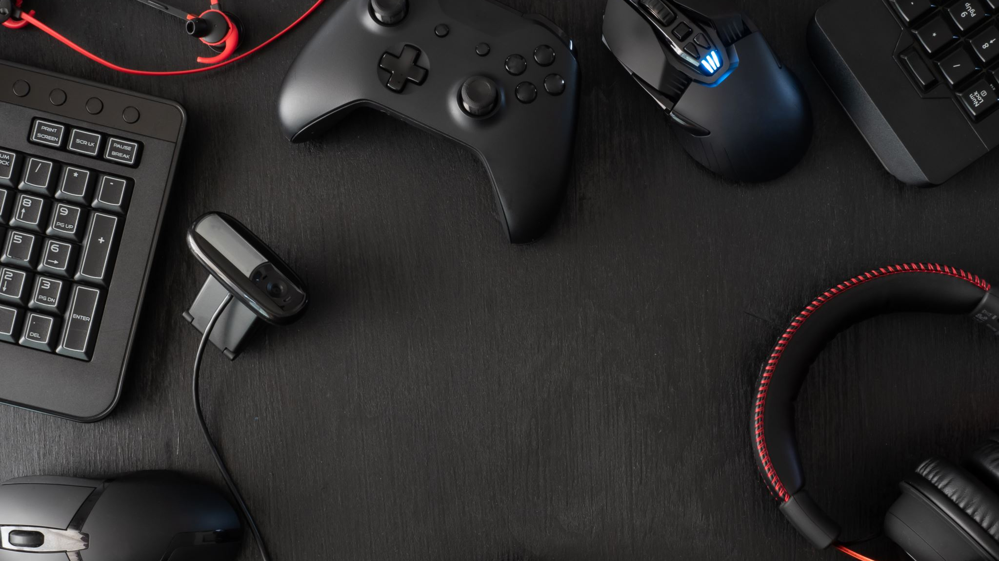
The Game Site
By Andrey Owen, Brandon Cooper, Logan Poe, Prosper Jibunor

Slide 2
Revised Idea
Our initial idea involved a site where you could learn to play all types of games, whether that be video games or board games.
We have since refined our idea to only focus on fighting video games such as Mortal Kombat and Super Smash Bros.
Following our customer interviews, it seems as though many gamers are interested in both learning to play games and helping others improve at games.
Additionally, we noticed many gamers who did not necessarily play fighting games but did play games competitively.
We are now considering expanding our idea to include other competitive online games.

Slide 3

Golden Pitch Canvas
WHO?
Who are the key players?
Professional gamers, casual gamers, and new gamers.
WHAT?
What can players do?
Learn about the game, learn the controls, submit strategies and tips.
What will the solution do?
Create a community, teach new gamers.
HOW?
How long does the solution last?
Until fighting games are irrelevant.
How many resources will the solution use?
One server if we plan to host it. People are our resource.
How will the solution behave?
Pro gamers will submit the controls and strategies and the casual and new gamers will consume the information.
WHERE?
Where will people use the solution?
To learn, improve, and teach.
WHEN?
When will people use the solution?
When they do not know the controls of a game, when they want to learn more about a playstyle.
WHY?
Why is the solution needed?
There are not many resources outside of YouTube videos for learning to play fighting games.

Slide 4
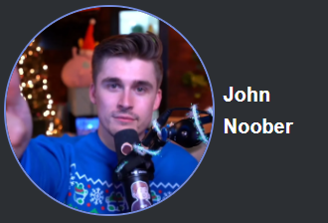
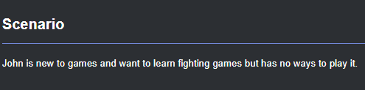
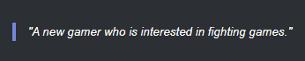
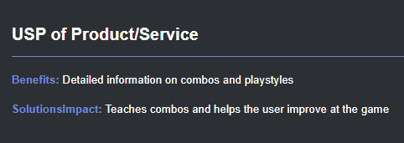
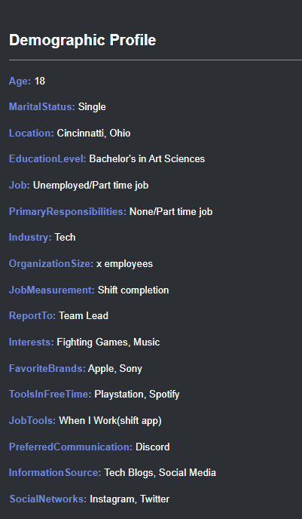
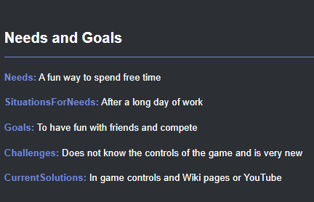
Customer Persona – New Gamer

Slide 5

New Gamer - Interviews
Austin
Austin enjoys playing battle royal and multiplayer shooter games. He has been playing games casually for 12 years. His goal when playing games is to win or be the best. He has recently started playing a lot of new games. He struggles to play games such as GTA because he does not know the controls or how to play. He noted he would play more if he could easily learn to play. He primarily has 1–2-hour gaming sessions with friends. His primary source of information for games is watching streamers.

Slide 6
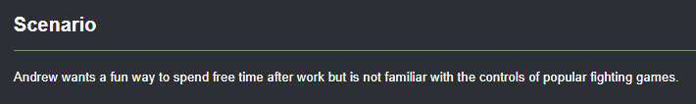
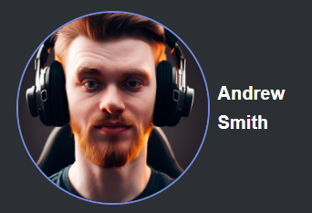
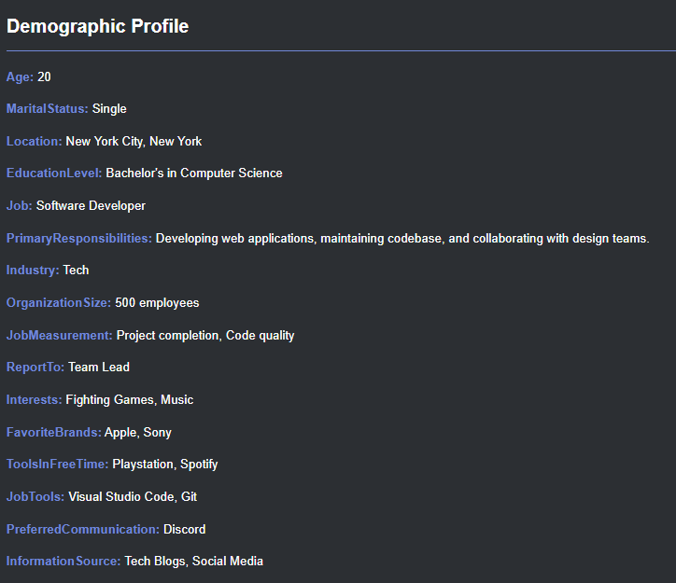
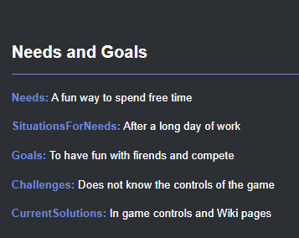
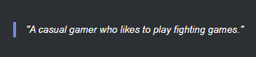
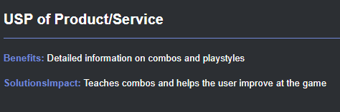
Customer Persona – Casual Gamer

Slide 7
Casual Gamer - Interviews
Ben M
Ben likes to play FPS, MMO, and RPG games. He has been playing for 12 years and considers himself to be a highly skilled player. His goal when playing games is to increase in skill and have fun with friends. Ben is actively trying to get better at R6 which he occasionally plays competitively. He has previously given others advice on how to play games.
Ben A
Ben likes to play RPG’s and sports games. He has been playing games for 15 years and considers himself to be extremely skilled at the games he plays. When playing games, he sometimes plays competitively. In games like FIFA, he has given others advice on how to get better at the game.

Slide 8
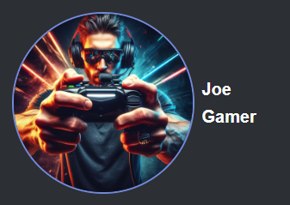
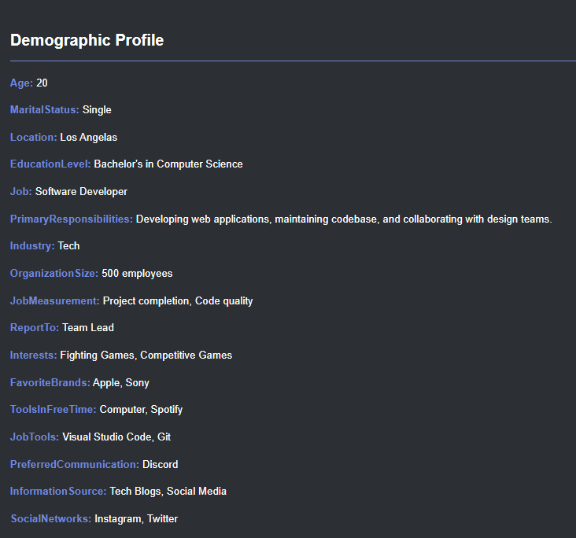
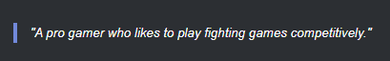
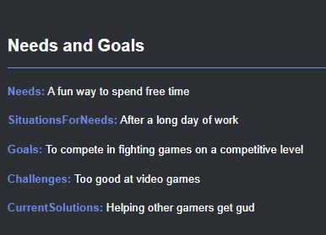
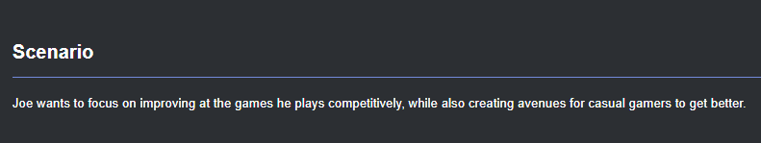
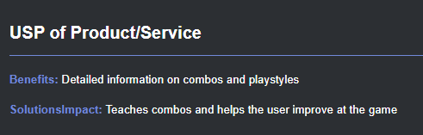
Customer Persona – Pro Gamer

Slide 9
Pro Gamer - Interviews
Alec
Alec stated he enjoys playing competitively, and always enjoys playing with friends that might be of lower level than him. He also like teaching people the things he knows about the games he plays
Grayson
Grayson stated he enjoys playing competitively, and he also mainly plays fighting games. He stated he gives plenty of advice on how combo strings work in fighting games and how to pull them off. Grayson also said he’s collaborated on a scrapped YouTube video that guided new Street Fighter 6 players on how to use multiple characters.
Mary
Mary plays Smash Ultimate competitively. She stated she doesn’t usually play with other people or guide them, however, she said she has lots of experience that she would want to share. She also is looking to improve in the game, stating the best place to learn is YouTube.

Slide 10

Value Proposition - New Gamer
Pains:
Little experience,
Little to not skill,
Doesn't know controls
Pain relievers:
Provides controls for a variety of fighting games and platforms
Product:
The Game Site
Process: Fighting games
Gain creators:
A place to find controls
Gains:
Ability to learn controls,
A place to find guidance

Slide 11
Value Proposition - Causal Gamer
Pains:
Plays casually but wishes to improve,
Struggles against
Experienced
opponents
Pain relievers:
Provides advanced combos for a variety of fighting games and platforms
Product:
The Game Site
Process: Fighting games
Gain creators:
A place to find advanced combos
Gains:
Ability to learn better combos, a place to learn

Slide 12
Value Proposition - Pro Gamer
Pains:
Wants to improve,
Can't share experiences well
Pain relievers:
Provides the avenues to share their experience with new to pro gamers
Product:
The Game Site
Process: Fighting games
Gain creators:
Ability to collaborate
Gains:
Ability to share their experience and possibly learn from other pros

Slide 13
The Business Model Canvas – New Gamer
Key partners: Pro gamers
Key activities: Interest in fighting games
Key resources: control guides for fighting games
Value proposition: a one stop site for fighting games guides
Customer relationships: Pro gamers creating accessible sites
Customer segments: Attempts to serve, new, casual, and pro gamers
Channels: User-driven content
Cost structure: Value-driven
Revenue streams: Advertising

Slide 14
The Business Model Canvas – Casual Gamer
Key partners: Pro gamers
Key activities: Interest in improving at fighting games
Key resources: control guides for fighting games
Value proposition: a one stop site for fighting games guides
Customer relationships: Pro gamers creating accessible sites
Customer segments: Attempts to serve, new, casual, and pro gamers
Channels: User-driven content
Cost structure: Value-driven
Revenue streams: Advertising

Slide 15
The Business Model Canvas – Pro Gamer
Key partners: Pro gamers
Key activities: Interest in sharing experience of fighting games
Key resources: control guides for fighting games
Value proposition: a one stop site for fighting games guides
Customer relationships: Pro gamers crating accessible sites
Customer segments: Attempts to serve, new, casual, and pro gamers
Channels: User-driven content
Cost structure: Value-driven
Revenue streams: Advertising

Slide 16
Competitor analysis - IGN
Pros
• Has guides for all the most popular games not just fighting games.
• Guides can have contributions from the community. As can our site.
• IGN creates their own video guides for some games. Our videos are all community sourced.
• Lots of articles on gaming news. We do not have articles (yet).
Cons
• Lots of advertisements. Our sites will not have standard advertisements.
• Majority of site lacks polish. Our site will be perfect.
• IGN has too broad of a focus. We plan to target specific types of individuals.

Slide 17
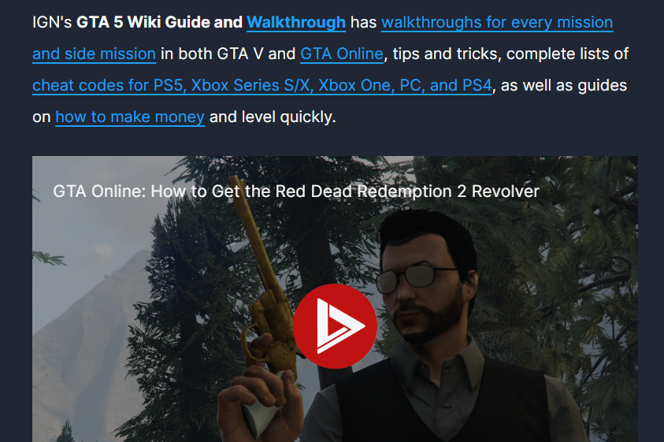
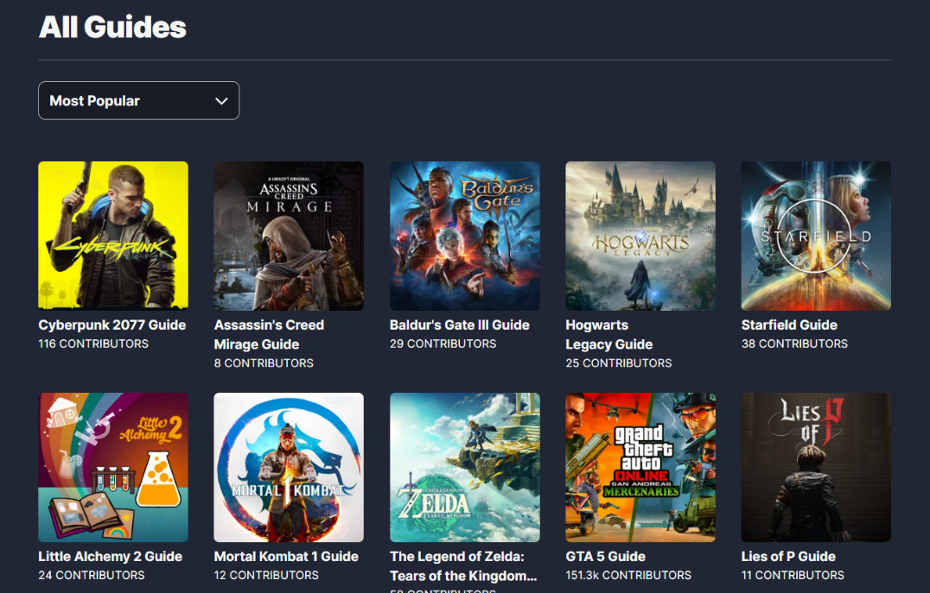
IGN - Site

Slide 18
Competitor analysis - KOTAKU
Pros
• Has tips and guides but they are all in the form of articles.
• Covers gaming news. We do not outside of new strategies.
• Has game reviews. We do not review games.
Cons
• Lots of advertisements. Our sites will not have standard advertisements.
• Lacks user generated content.
• Does not cover controls. Our site will.

Slide 19

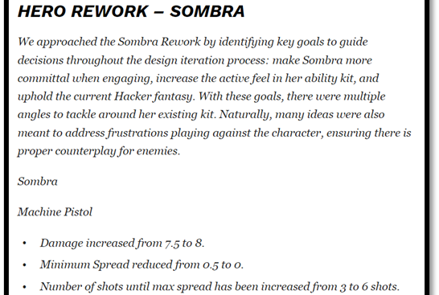
KOTAKU - Site

Slide 20
Competitor analysis - YouTube
Pros
• Very clean interface. Our site will also be clean.
• Videos for any game imaginable.
• Limited number of advertisements. Our site will also have very few.
• Everything is user generated.
Cons
• This site does not have information in text format.
• The type of videos on the site are very broad.
• Controls and information may not be covered in a way that helps a user.

Slide 21
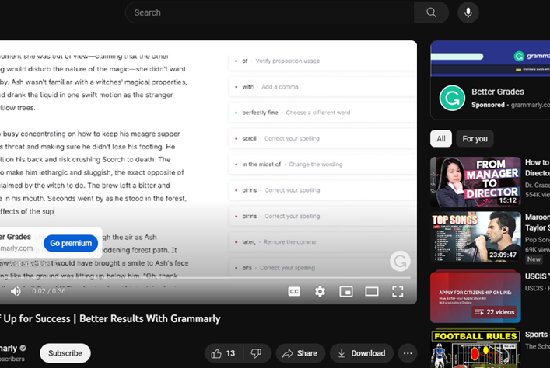
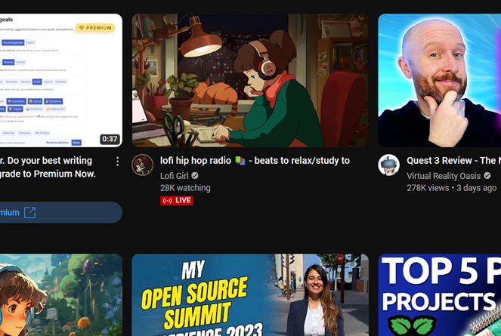
YouTube - Site

Slide 22
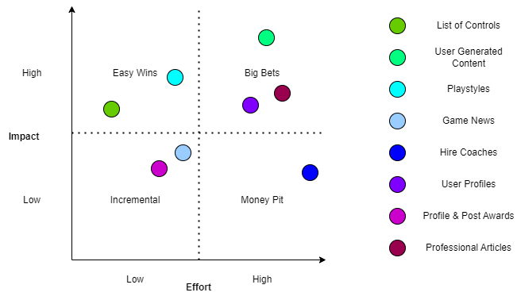
Impact VS Effort Feature Map

Slide 23
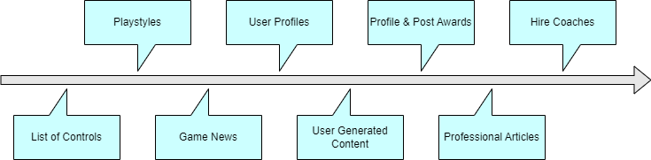
Feature List Timeline

Slide 24
SWOT Analysis
Strengths:
• Utilize the ability to create community with gamers by allowing users to upload their own combinations
• Centralizes controls for multiple games in a place that is user friendly
• Team has background in Web Development
• Only selecting a niche group of games (fighting games). So not focused on every game in existence for prototype
Weaknesses:
• Not much to work off (no website like it exists)
• Competitors are much bigger and have larger audience.
• Still In the planning phase as we work on our website
Opportunities:
• Few to no websites like it so we have a chance to take over a market.
• With more games like the Street Fighter 6, MK1, DBFZ the want to learn combos is growing
Threats:
• YouTube is one of the largest platforms on the earth, and also our largest competitor
• Built-In game guides
• Wikis
• IGN

Slide 25

PESTEL Analysis
Social:
Reframing fighting games as a method of building community
Legal:
Companies may not like their games being represented without permission

Slide 26
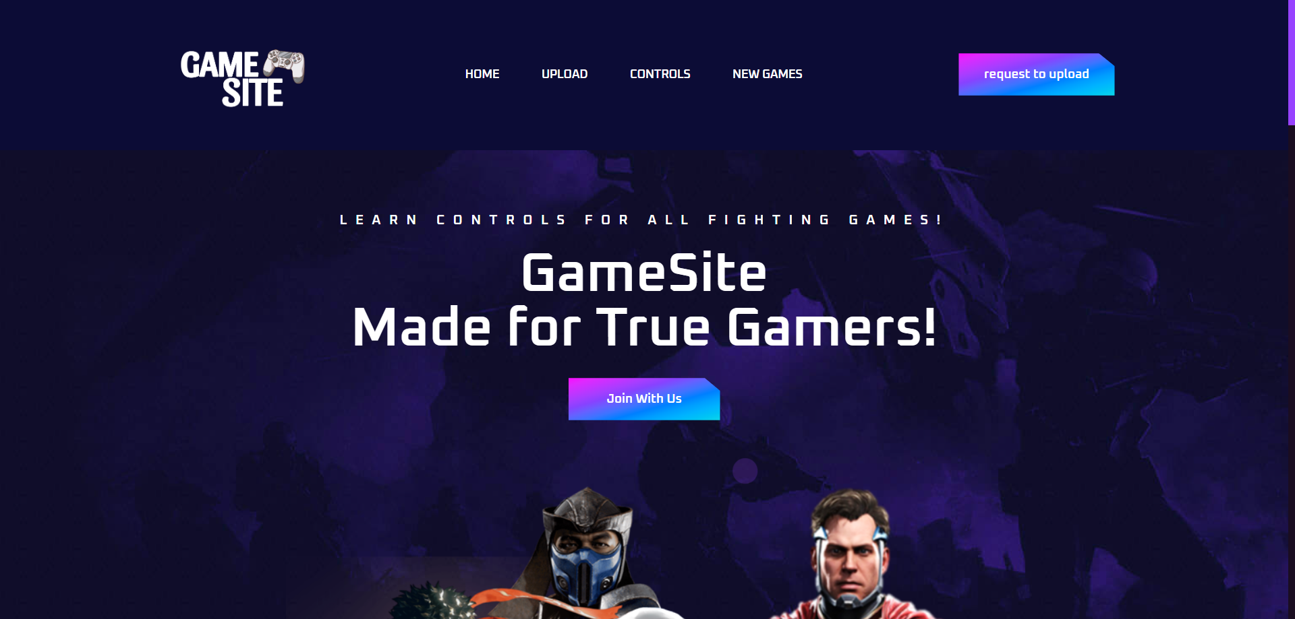
User Interface

Slide 27
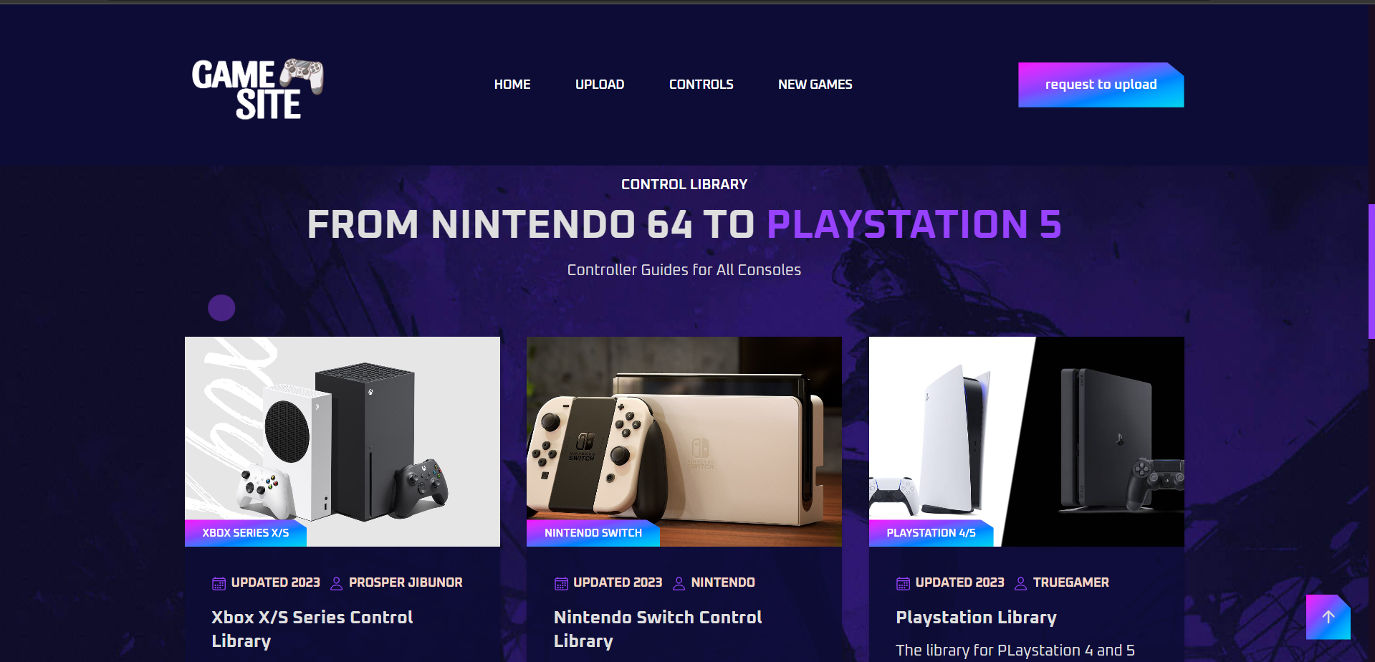

Slide 28
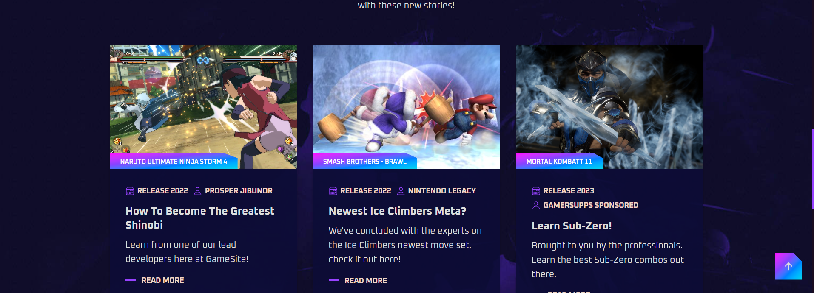

Slide 29
